Slide 1

Portland housing prices and crime data
Team Brainy Bunch

Slide 2

The Idea
Portland, OR has been one of the fastest growing metropolitan areas in the United States over the course of the last decade.
The growth has brought both a massive increase in housing prices and an increase in crime.
Team Brainy Bunch set out to determine if there was a correlation between the average prices of homes and the amount of crime committed in a neighborhood.
Photo by Steve Morgan

Slide 3
The First Steps
Generation: Data on housing prices, as well as crime, has already been generated by realtor.com and the Portland Police Bureau
Collection: A web scraping program written in Python collected all requisite data from realtor.com
Processing: The data was cleaned to leave only the most salient features

Slide 4
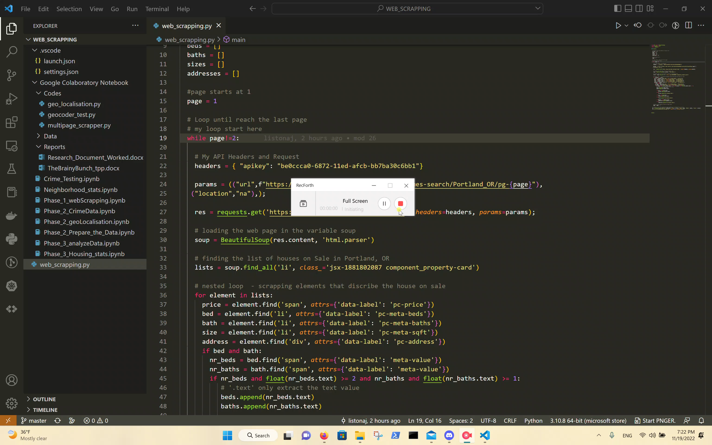
The Program

Slide 5
The Housing Data
Data retrieved from the web scraping program was stored in a .csv file in the following format:
Address,Price,Beds,Baths,Sizes
"1150 NW Quimby St Unit 906, Portland, OR 97209","$1,039,900",2,3,"1,612sqft"
"2939 SE Bybee Blvd, Portland, OR 97202","$1,675,000",5,3,"4,592sqft"
"8420 NW Whitney St, Portland, OR 97231","$659,000",3,2,"1,680sqft"
The most relevant pieces of data received were the address and the price of the listed house.

Slide 6
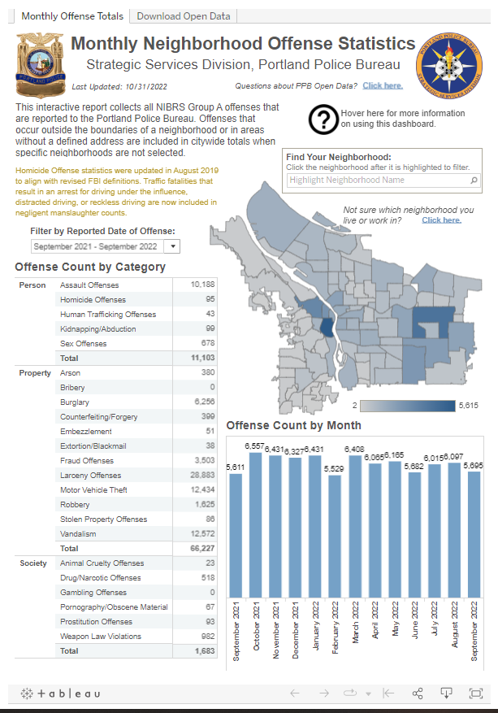
The Crime Data
Much easier to come by.
All data is openly hosted by the Portland Police Bureau for access by the general public.
Can be downloaded as a .csv file.
https://www.portlandoregon.gov/police/71978

Slide 7
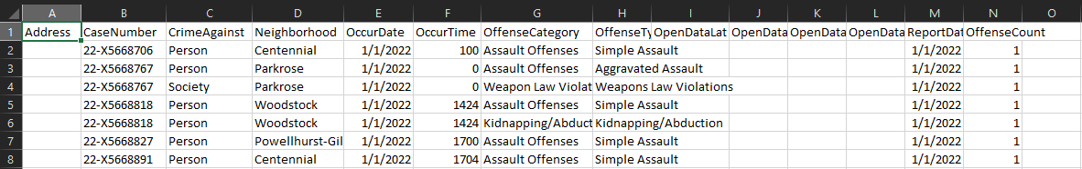
The Crime Data, cont.
The crime data was retrieved in the above format.
The most salient data above is the type of crime as well as the neighborhood in which the crime was committed.
It is important to note that in the interest of protecting privacy, the Portland Police Bureau does not provide the address where the crime was committed.

Slide 8
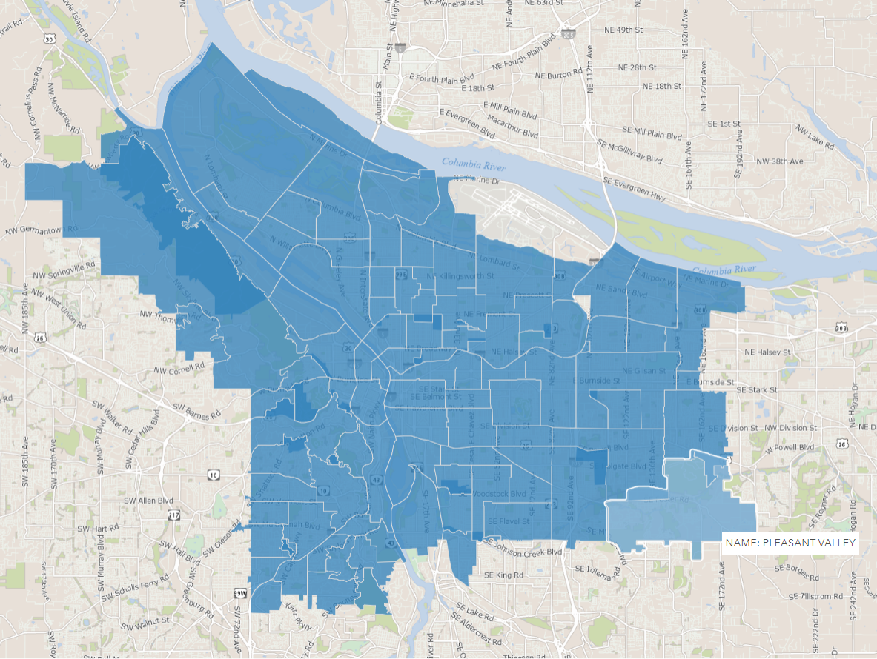
The Data Collation
PROBLEM:
Housing data has addresses but no neighborhoods
Crime data has neighborhoods but no addresses
SOLUTION:
Performed a spatial join using ArcGIS
Housing data was loaded into ArcGIS and the resulting map was overlayed with a shapefile of Portland neighborhood boundaries
Resulting .csv gave the neighborhood that each address fell into as well as the X,Y coordinates of that address
https://gis-pdx.opendata.arcgis.com/datasets/neighborhoods-regions/explore?location=45.540936%2C-122.625293%2C11.93

Slide 9
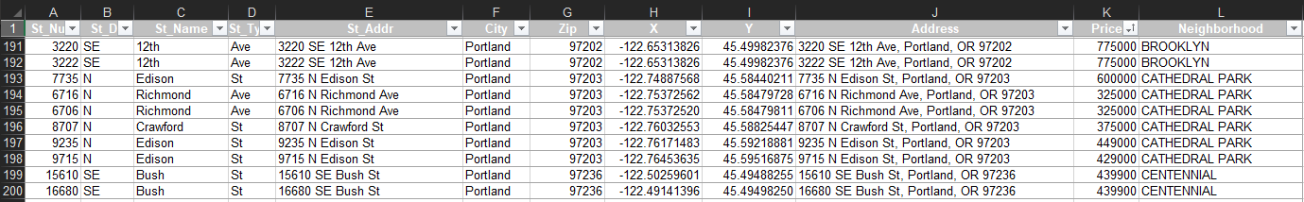
The Finalized Housing Data
Columns J, K, and L show the most relevant information.
Address, Price, and neighborhood.
Also, note the X,Y coordinates in columns H and I.

Slide 10
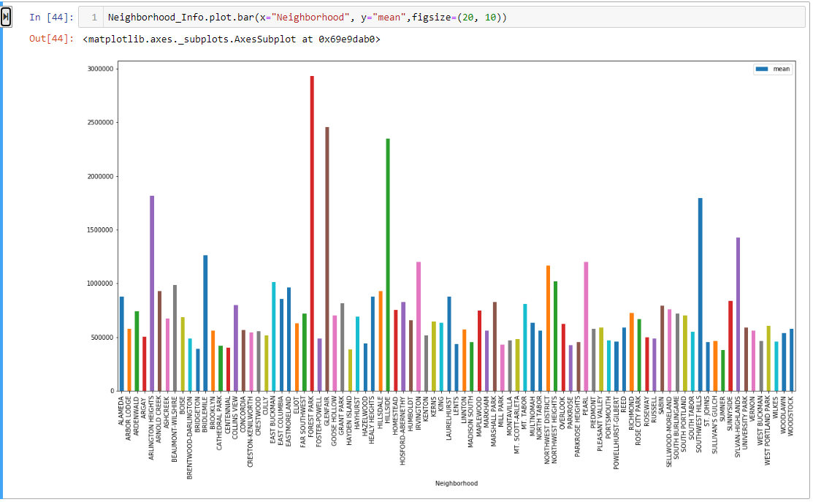
The Housing Data, totals Mean price by neighborhood:

Slide 11
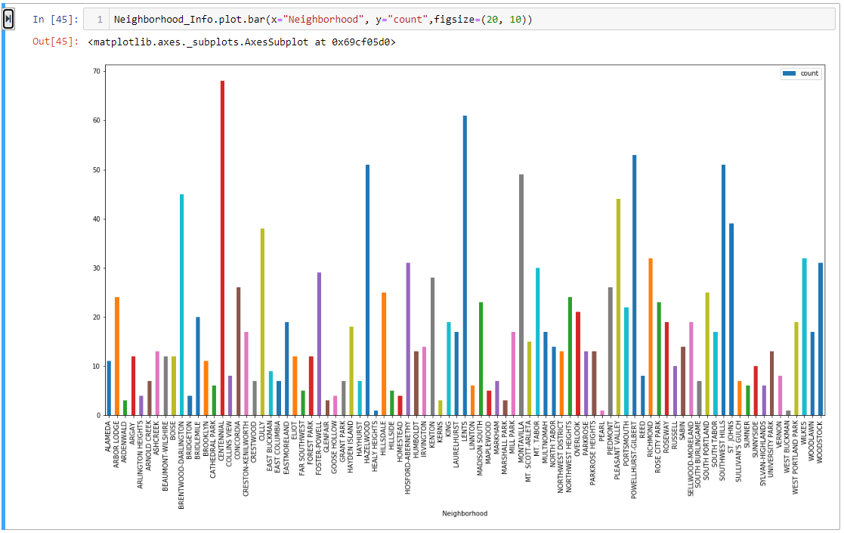
The Housing Data, totals Number of listed properties by neighborhood:

Slide 12
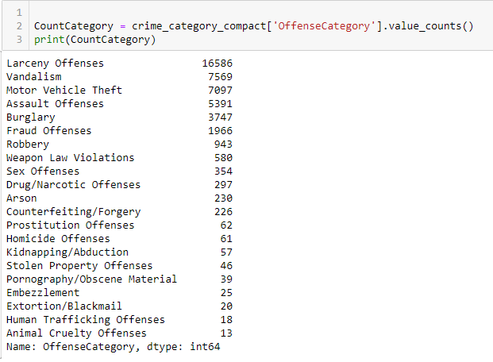
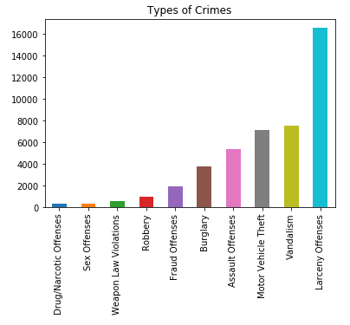
The Crime Data, totals

Slide 13
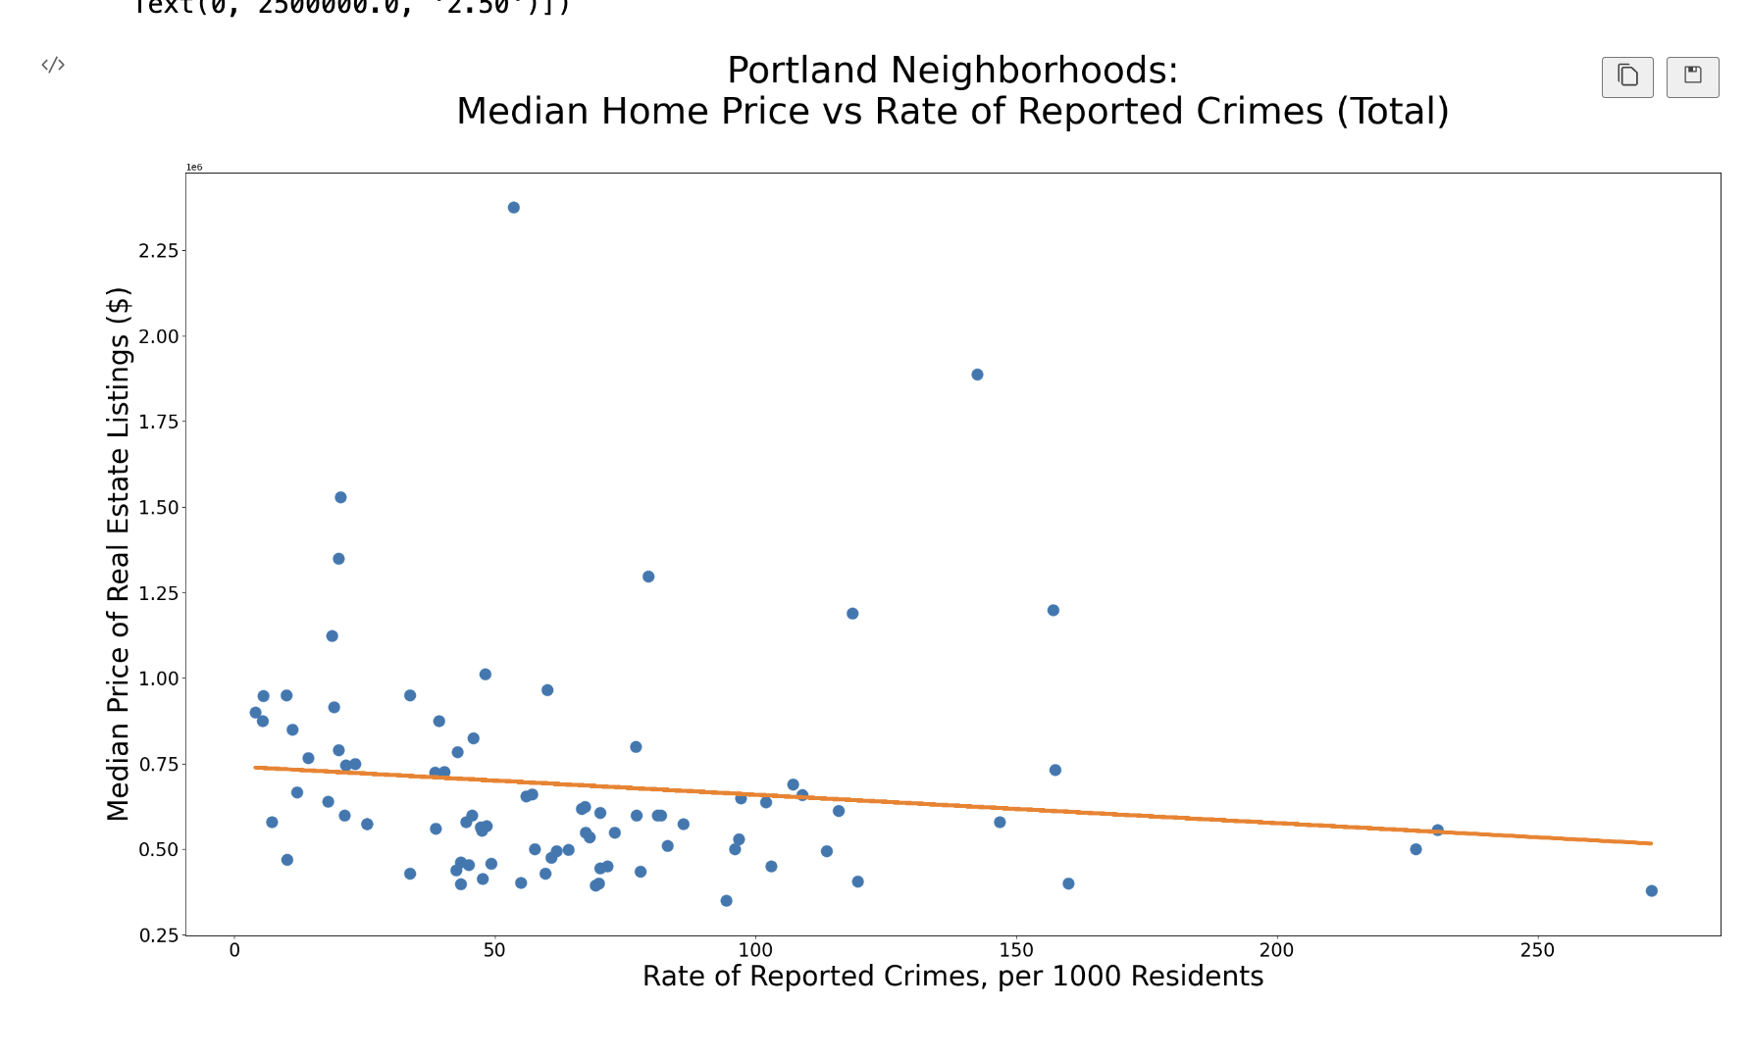
The Analysis

Slide 14
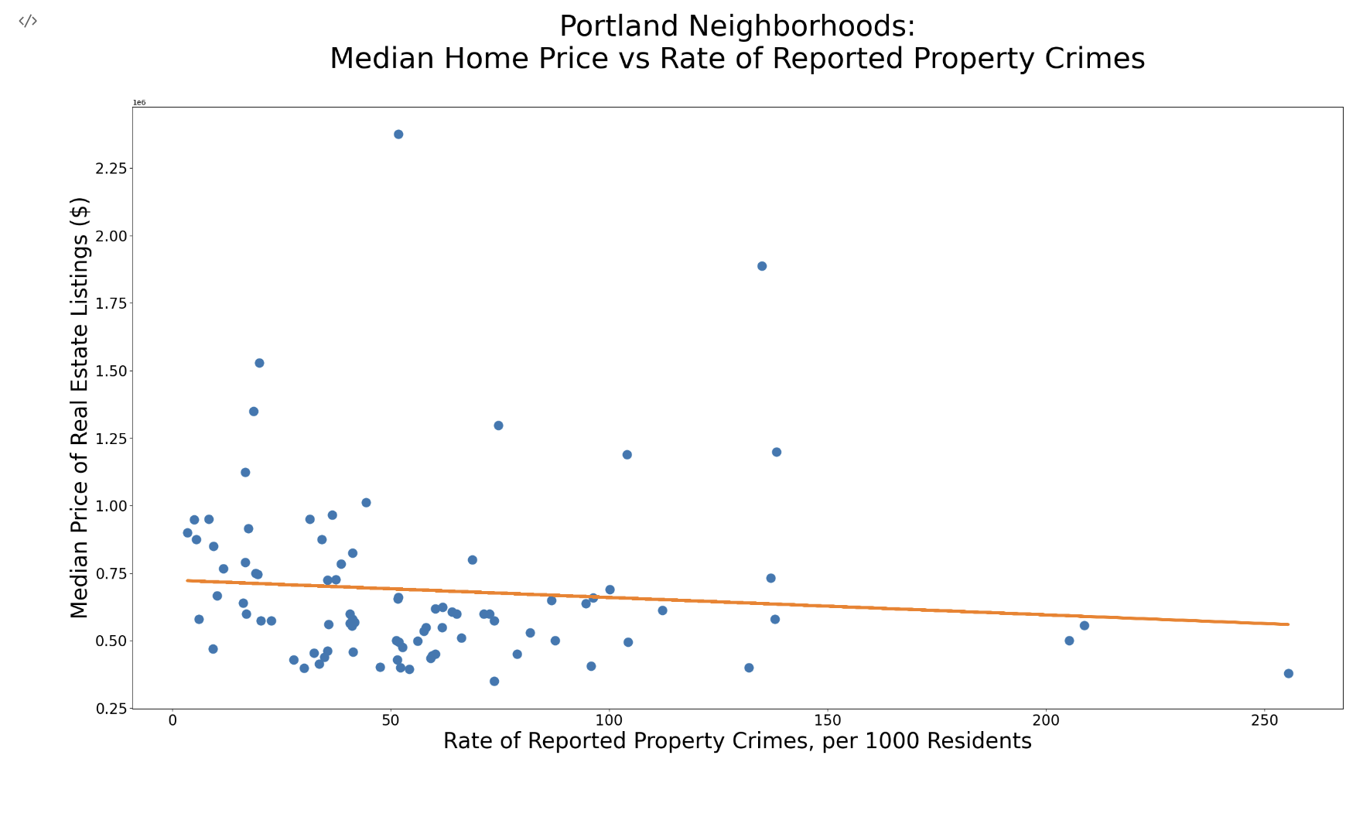
The Analysis, cont.

Slide 15
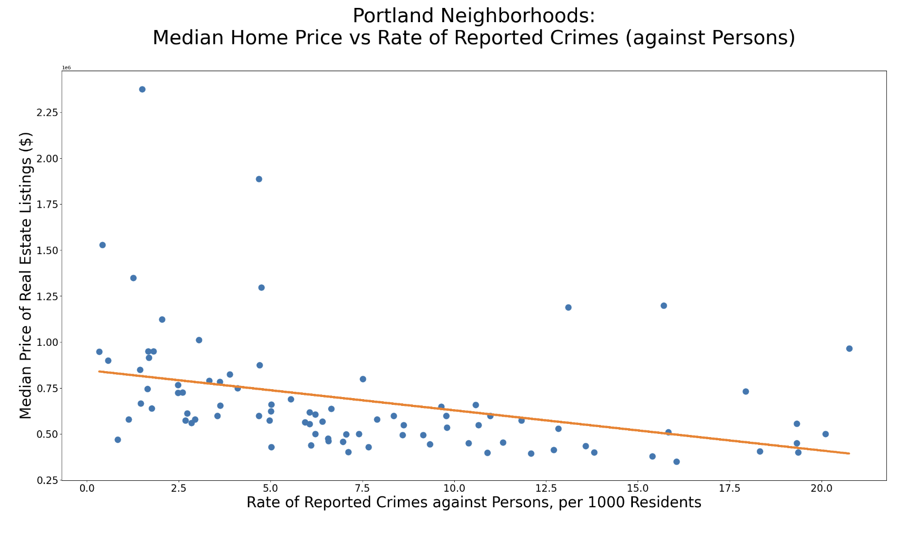
The Analysis, cont.

Slide 16
The Conclusion
There was a decrease in median home price across all three comparison metrics
Total reported crimes, reported property crimes, reported crimes against persons
Important to note, correlation does not imply causation
Multiple historic and socio-economic factors at play
Potential further research and activities:
PPB hosts open data as far back as 2015
Could attempt to locate historical neighborhood housing prices
Create a crime map and overlay it on the city of Portland

Slide 17
Thank you!!
Jean-Marc Romain, Georgette Powley,
Treyce Kangas-Simons, Elias Pennell

